Slide 1




RNA-seq: choosing your strategy
Elizabeth Permina
OGBF, University of Otago 2017
With the support of:

Slide 2
Analysis types
RNA-Seq
RNA-Seq
de novo Transcriptome assembly
Splice variants
Gene expression

Slide 3
Bench-stage decisions
Sequencing
Post-processing
Getting read counts
Choosing analysis pipeline/package

Slide 4
Bench-stage decisions
Library / kit type
Biological replicates

Slide 5
Sequencing
Single end or Paired end?
Coverage – how much and how is affecting the results?
Notes:
Seqanswers says:
- Paired end gives an idea of the size of the insert and the directionality of the mapping to the sequence assembly algorithms. This aids in prediction of inversions, deletions and mutations inside the genome.
- High quality of mapping of reads in regions with repeat content, Single end reads are woefully unsuitable to accurately predict transcription in repeat containing regions.
First, it gives you a better "coverage" of your transcripts. In contrast to eukaryotes with splicing, you can be fairly sure that the piece in between the mapped read pair is present in your cDNA, so you can create a fake read covering the whole piece of cDNA.
Second, you get a better resolution of the 3'-ed of your transcript. That can help you to better define 3'-UTRs and novel ncRNAs where you cannot infer the likely end from a stop codon.
Third, it allows you to better define polycistronic mRNAs and thus operons.
Last but not least: Back when sequencing length was still an issue, you could get all the above from sequencing just 2x 20-25bp (usually more than enigh to properly map a read within a bacterial chromosome).
Oh, and if you do metatranscriptomics, paired end data will help you tremendously to assemble unknown transcripts.

Slide 6
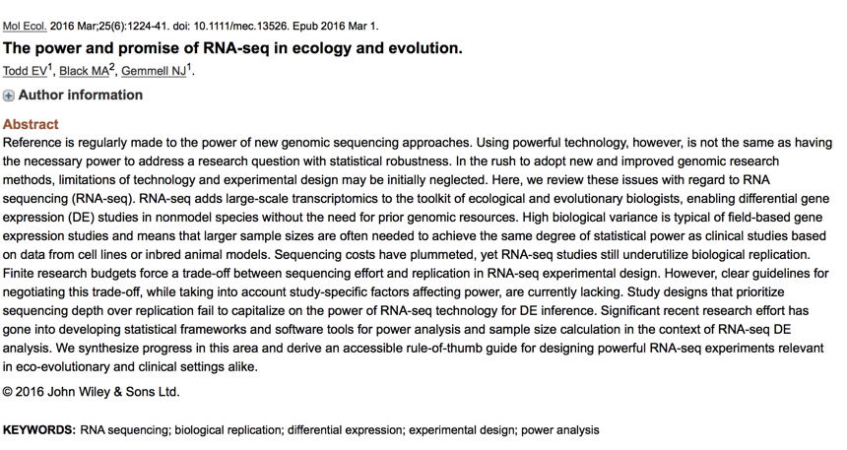
Notes:
On coverage-replicates tradeoff

Slide 7
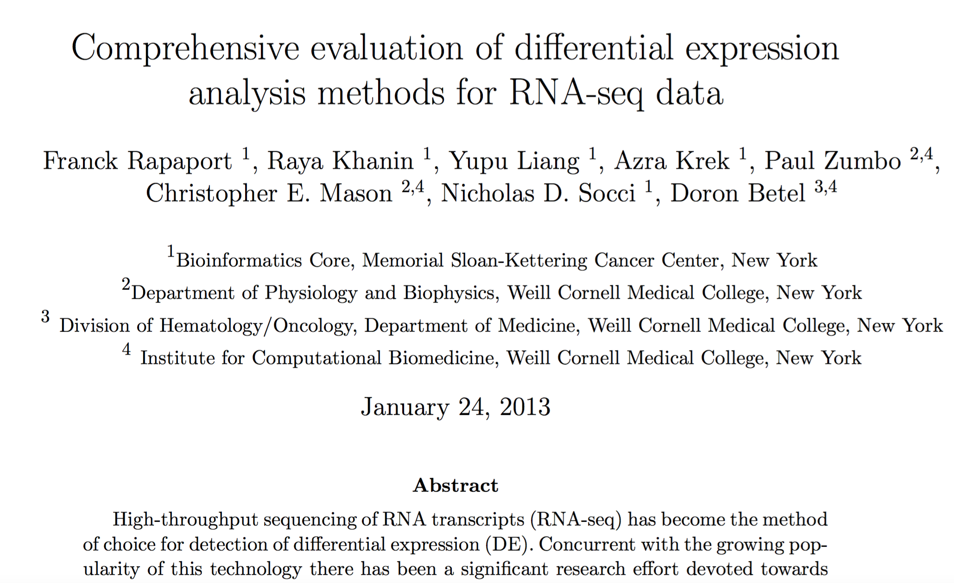
Notes:
Coverage, replicates and different stats packages discussed

Slide 8
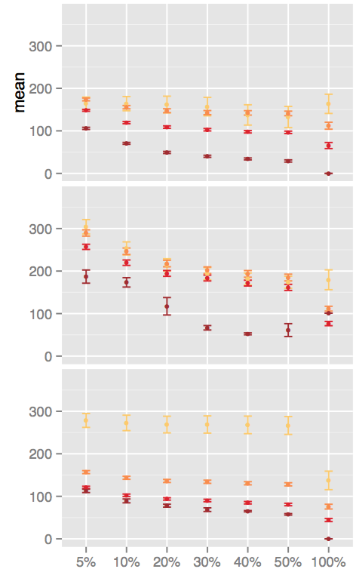
#Coverage-depth
Notes:
Limma QN, Limma voom, PoissonSeq

Slide 9
Post-processing
QC and adapter trimming – to do or not to do?

Slide 10
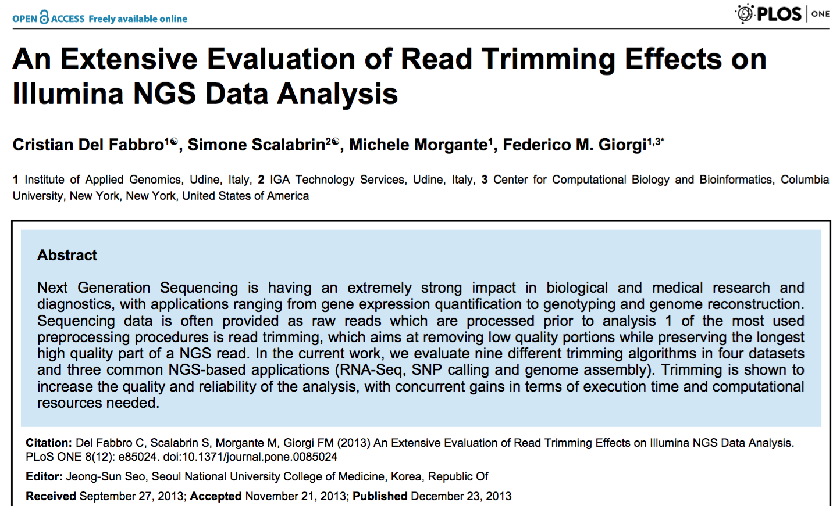
Notes:
Should I quality trim?
Cristian thinks you should (because % of mapped reads will increase, up to the point)

Slide 11
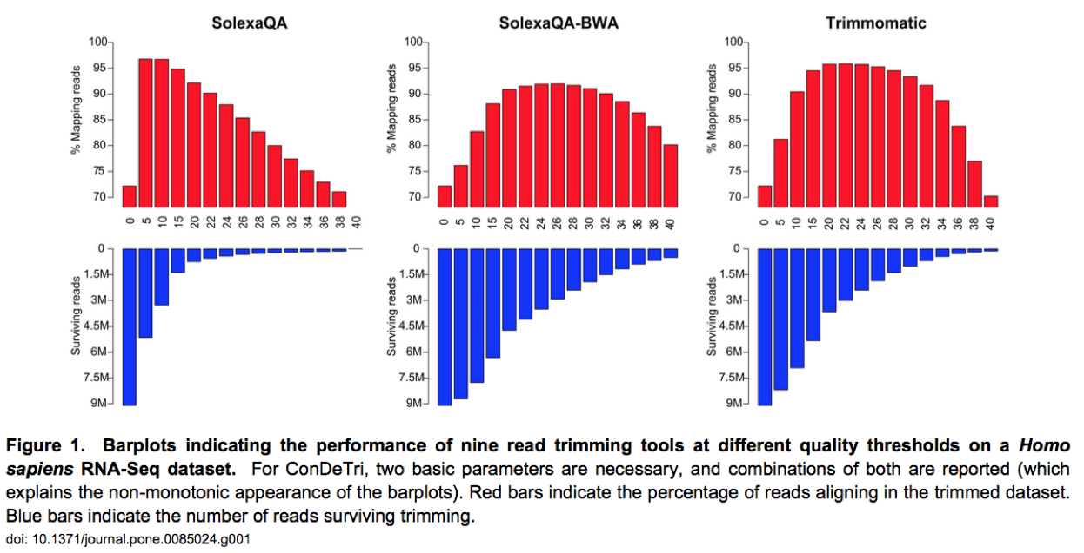
Notes:
… but then decrease again

Slide 12

Notes:
While Matthew thinks that “anything more than VERY gentle trimming is harmful to de novo assembly and transcriptome characterization. My findings seem to be in conflict with those presented by Giorgi and colleagues. I\’ll tell you up from that I think I\’m right, at least for the RNAseq part of their paper”.
AND
“With regards to RNAseq, they show that percentage of reads mapped to the reference increases with moderate trimming (red bars), then decreases with more aggressive >Q30 trimming.. Note that I don\’t think that better mapping is necessarily equivalent to better RNAseq results”

Slide 13
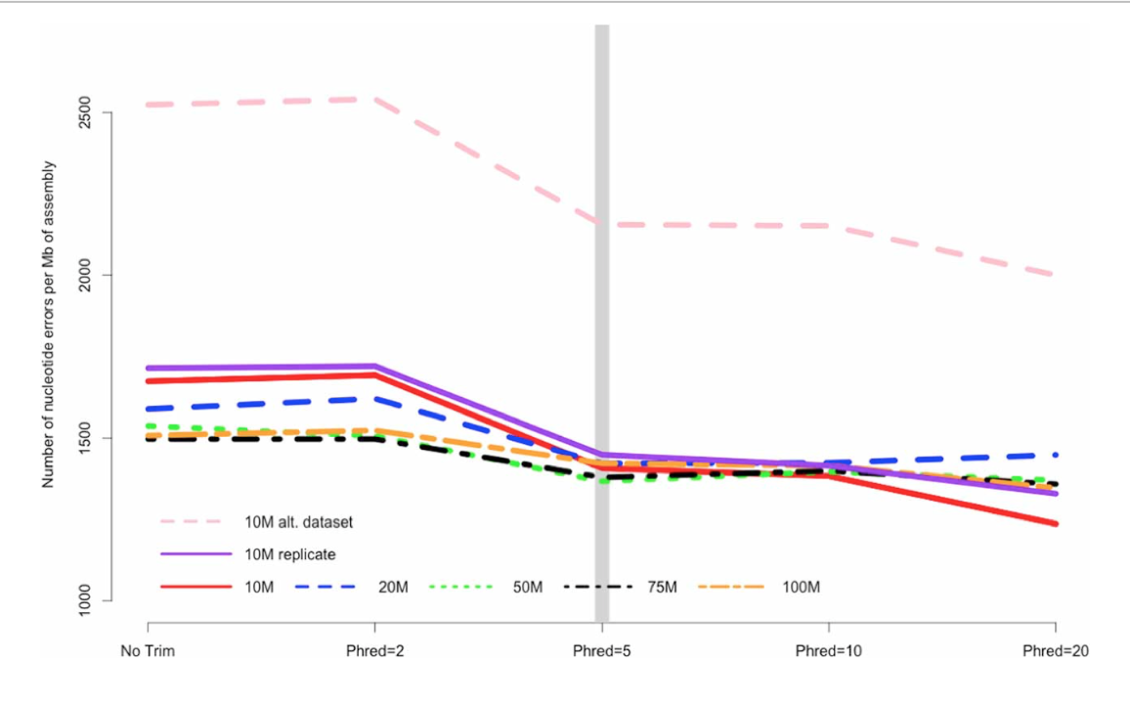
Notes:
The number of nucleotide errors contained in the final transcriptome assembly, normalized to assembly size, is related to the strength of quality trimming. This pattern is largely unchanged with varying depth of sequencing coverage (10–100 million sequencing reads). Trimming
at PHRED = 5 may be optimal, given the potential untoward effects of more stringent quality trimming. 10, 20, 50, 75, 100 M refer to the subsamples size. 10 M replicate is the technical replicate, 10 M alt. dataset is the secondary dataset. Note that to enhance clarity, the Y-axis does not start at zero.

Slide 14
Getting read counts
HTSeq
Picard
Bedtools
Tuxedo

Slide 15
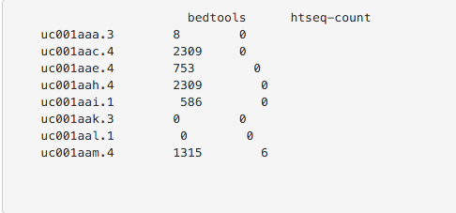
HTSeq vs Bedtools
Notes:
HTseq-count drops reads that can not be assigned unambiguously based on program parameters deciding rules http://www-huber.embl.de/users/anders/HTSeq/doc/count.html.
If you have isoforms of a gene with overlapping exons, htseq-count will discard reads that fall into these exons. You should find the count of reads in the 'ambiguous" output row.
bedtools will assign them to every isoform where there is an overlap, you should have more counts than reads for the same annotation where you have htseq-ambiguous reads.
HTseq-count is said to be able to assign reads to ensembl-GTF file genes by aggregating over isoforms combined by the "gene_id". I was unlucky until now to make this work well.

Slide 16
Choosing analysis pipeline/package
edgeR
DeSEQ/DeSEQ2
Limma Voom
Limma QN
PoissonSeq
Cufflinks

Slide 18
Data
Authors of Rapaport et al., 2013 used samples from two biological sources that were part of the SEQC study:
contain the Strategene Universal Human Reference RNA (UHRR), which is composed of total RNA from 10 human cell lines.
The second group of samples contains the Ambion Human Brain Reference RNA (HBRR).
All sequenced libraries were mapped to the human genome (hg19) using TopHat(v.2.0.3)
True positive set was declared as an intersection of DESeq, edgeR, limmaVoom and baySeq results.
Notes:
Note: mapping param. they used: -r 70 --mate-std-dec 90.

Slide 19
Coverage simulation
Authors of Rapaport et al., 2013 used DownsampleSam, function from Picard that randomly samples read pairs, from a SAM file, using a uniform probability. We generated a first set of reduced coverage depth sample by downsampling every file A1 to A5 and B1 to B5 with a probability of p1 = 0.5 for retaining each read.
This downsampling cascade was continued, ultimately generating six sets of files with respective probabilities 0.5, 0.4, 0.3, 0.2, 0.1 and 0.05 of retaining each pair of reads from the original files.

Slide 20
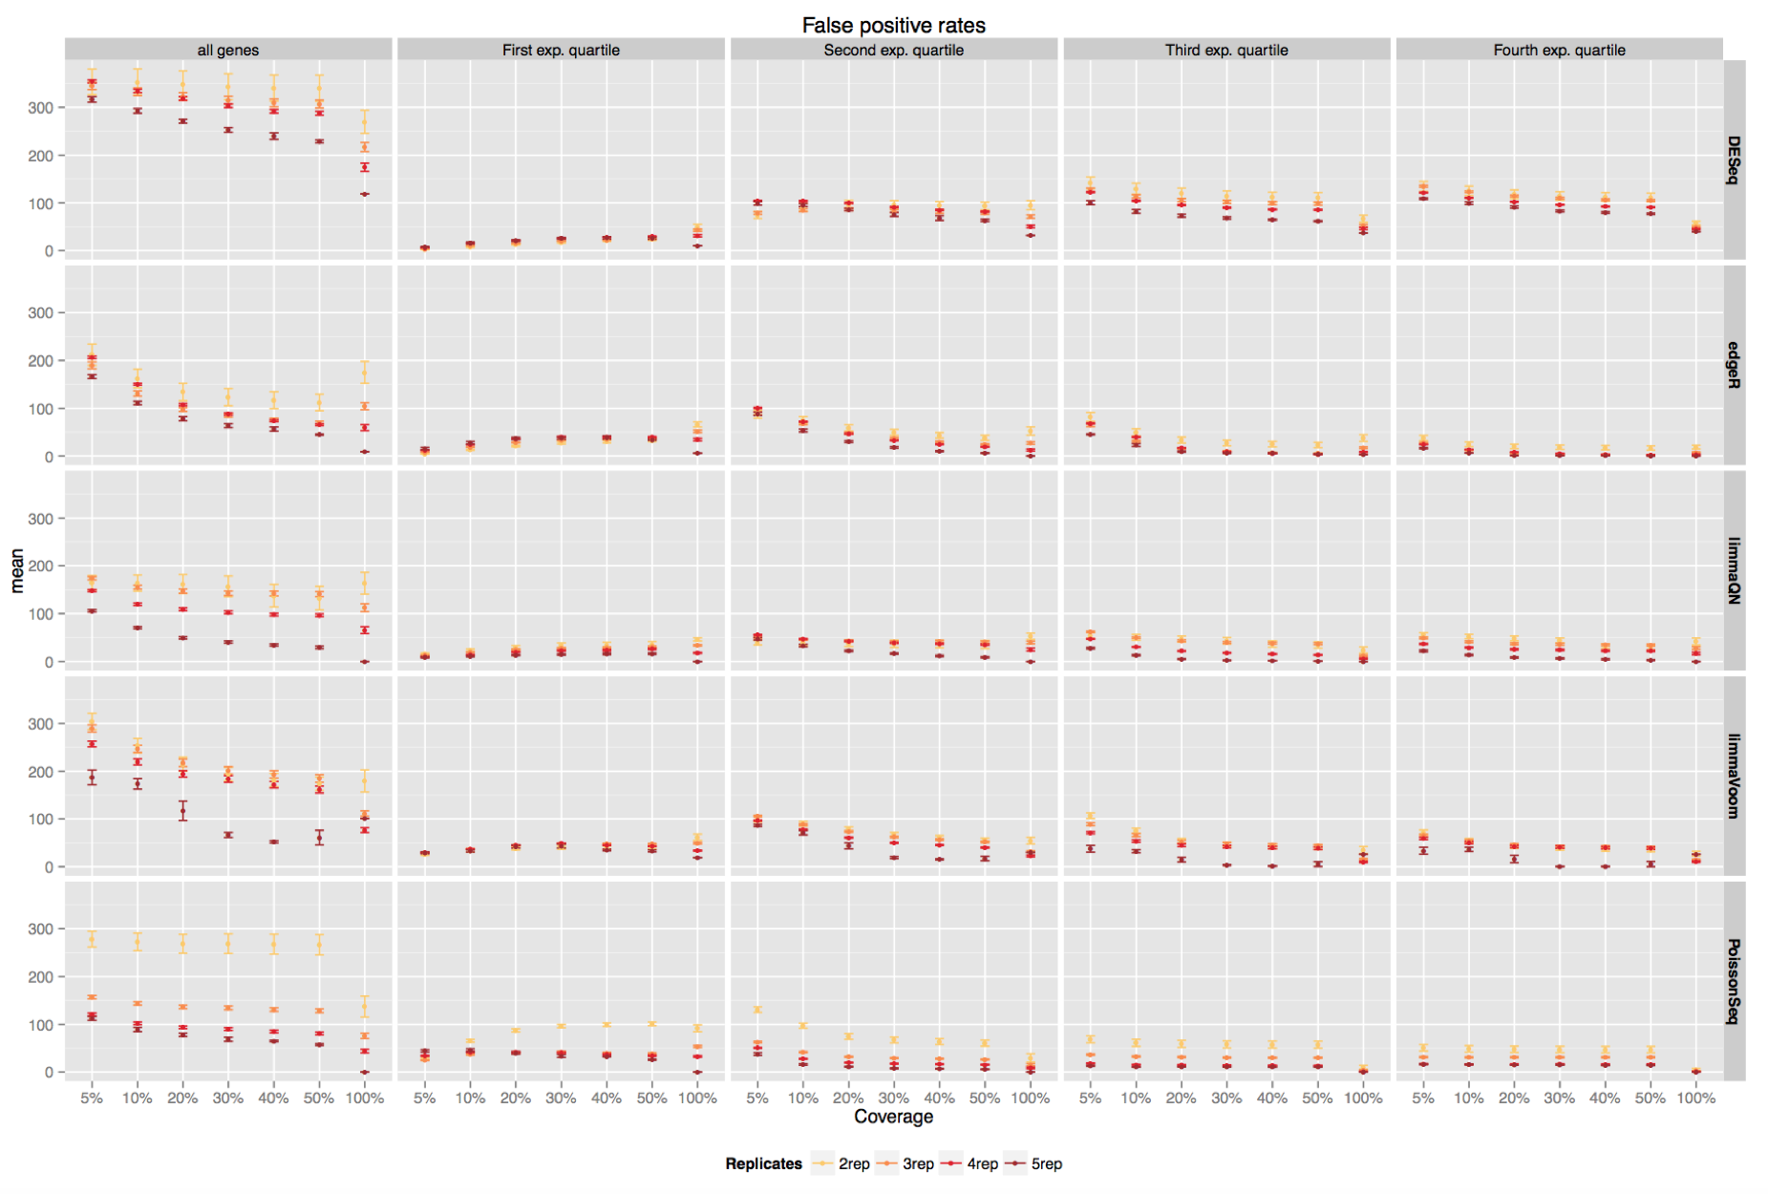
Notes:
False positive rates of DE with increasing coverage and sequencing depth
(y-axis - false positive (FP) rates, defined as the number of genes identified only by the evaluated algorithm, color – N of reps, x-axis – coverage percentage)

Slide 21
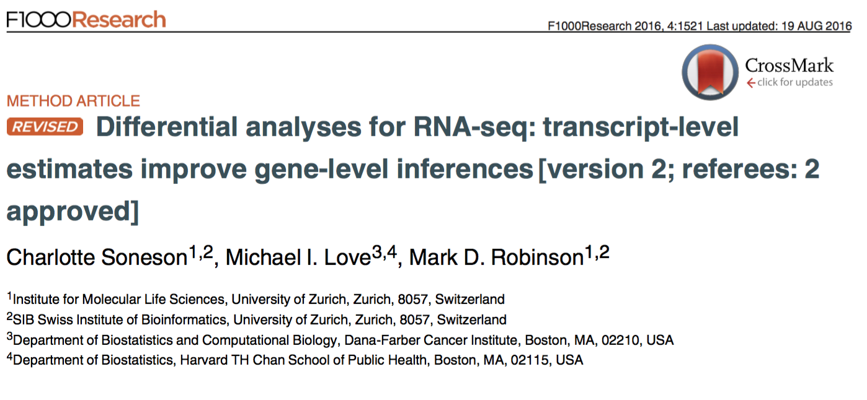
Notes:
“Many transcriptomic studies aim at comparing either abundance levels or the transcriptome composition between given conditions, and as a first step, the sequencing reads must be used as the basis for abundance quantification of transcriptomic features of interest, such as genes or transcripts.
In this paper, we show that gene-level abundance estimates and statistical inference offer advantages over transcript-level analyses, in terms of performance and interpretability.
We also illustrate that the presence of differential isoform usage can lead to inflated false discovery rates in differential gene expression analyses on simple count matrices but that this can be addressed by incorporating offsets derived from transcript-level abundance estimates.
We also show that the problem is relatively minor in several real data sets. Finally, we provide an R package (tximport) to help users integrate transcript-level abundance estimates from common quantification pipelines into count-based statistical inference engines. “

Slide 22
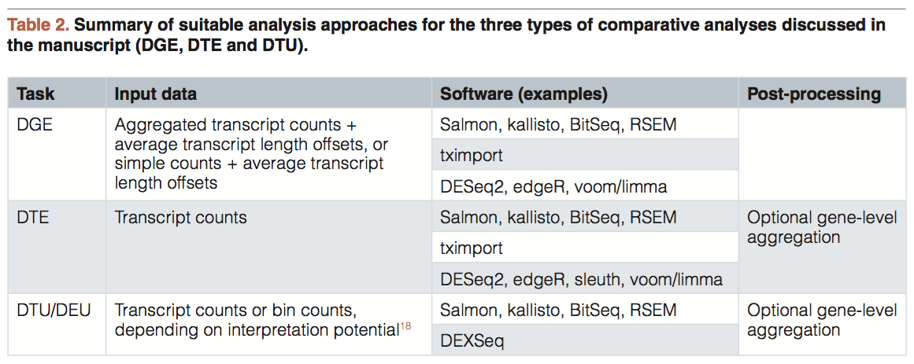
Gene level or transcript level?

Slide 23
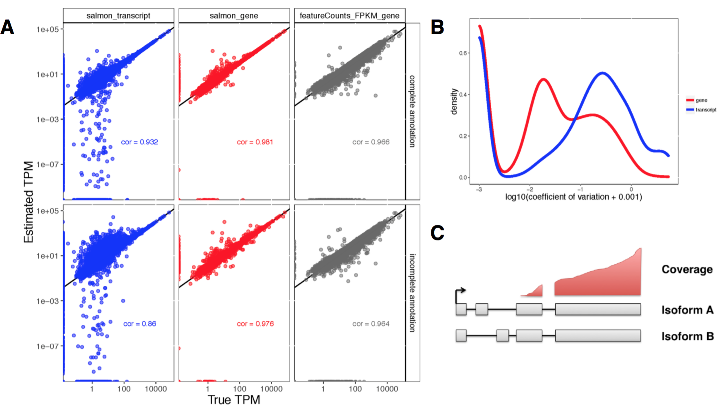
Notes:
Gene-level TPM estimates, representing the overall tran- scriptional output of each gene, were obtained by summing the cor- responding transcript-level TPM estimates. For the two simulated data sets, the true underlying TPM of each feature was known and we could thus evaluate the accuracy of the estimates. Unsurpris- ingly, gene-level estimates were more accurate than transcript-level estimates
Accuracy of gene- and transcript-level TPM estimates from Salmon and scaled FPKM estimates derived from simple counts from featureCounts, in one of the simulated samples (sampleA1). Spearman correlations are indicated in the respective panels. Top row: using the complete annotation. Bottom row: using an incomplete annotation, with 20% of the transcripts randomly removed. Gene- level estimates are more accurate than transcript-level estimates. Gene-level estimates from Salmon are more accurate than those from featureCounts.

Slide 24
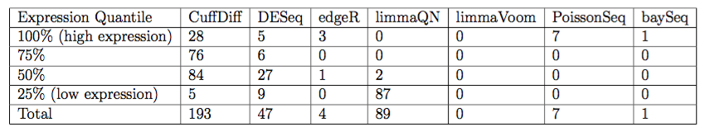
#package comparison
Number of false DE genes predicted by each method at adjusted p-values (or FDR) 0.05 separated by expression quantiles

Slide 25
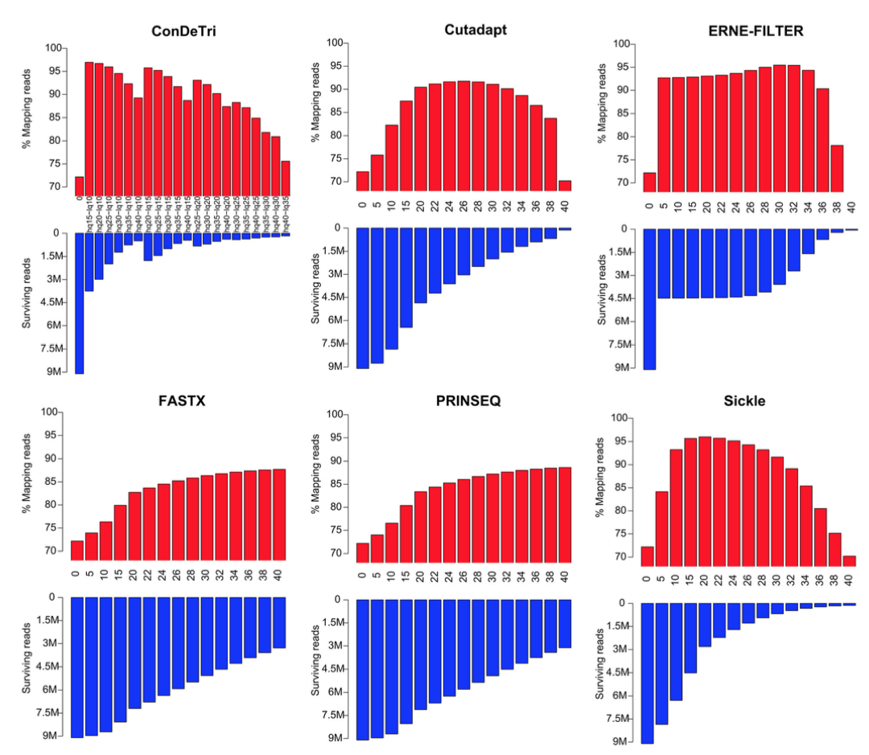

Slide 26
STAR vs Salmon vs Kallisto
Notes:
https://github.com/crazyhottommy/RNA-seq-analysis/blob/master/salmon_kalliso_STAR_compare.md
(PART3)
RNA-seq Data Analyses
Understand split-read mapping
Run different split-read mappers (tophat, hisat2, STAR)
Understand the Tuxedo Suite (cufflinks, cuffcompare, cuffmerge, cuffdiff, etc.)
Predict new transcripts/isoforms using cufflinks/cuffmerge
Quantify exons/genes/transcripts
Predict
Differential exon usage using DEXseq/DEXSeq2
Differential gene expression using DEseq/DEseq2
Map or pseudomap?
Differential isoform expression using cuffdiff

Slide 27
Understanding design matrices
What is Intercept?
Where is my first condition
Is my gene upregulated or downregulated
How do I compare more then one condition?
glm function, contrasts, interaction column in design matrix
Notes:
How many conditions are you comparing
Statistical power - a reminder to check your number of replicates
Deseq/deseq2/dexseq2 - contrasts
edgeR glm function
Examples of design matrices with comments

Slide 28
Complex designs
genotypes <- factor( c("cultivar1", "cultivar1", "cultivar1", "cultivar1", "cultivar2", "cultivar2", "cultivar2", "cultivar2") )
groups <- factor( c("drought", "drought", "watered", "watered", "drought", "drought", "watered", "watered") )
design <- model.matrix(~genotypes + groups)
Notes:
http://seqanswers.com/forums/showthread.php?t=12502

Slide 29
Complex design
1 cultivar1 drought chamber1
2 cultivar1 drought chamber2
3 cultivar1 watered chamber1
4 cultivar1 watered chamber2
5 cultivar2 drought chamber1
6 cultivar2 drought chamber2
7 cultivar2 watered chamber1
8 cultivar2 watered chamber2

Slide 30
Complex design
design <- model.matrix(~genotypes+groups+chambers)
y <- estimateGLMCommonDisp(y, design)
fit <- glmFit(y,design)
results.groups <- glmLRT(y,fit,coef=2)
topTags(results.groups)
This gives a list of transcripts different between watered vs drought, adjusting for cultivar and chamber differences.
To get the watered vs drought effects for cultivar1 and cultivar2 separately, you can use
design <- model.matrix(~genotypes+genotypes:groups+chambers)
then
results <- glmLRT(y,fit,coef=3)
for cultivar1 and
results <- glmLRT(y,fit,coef=4)
for cultivar2

Slide 31
Complex design - deseq
Three cell types, wild type vs a knockout
1. For KO condition, I would like to perform a comparision between each cell type
2. For each cell type, I would like to compare between KO and WT
Notes:
dds$group <- factor(paste0(dds$celltype, dds$condition))
design(dds) <- ~ group
dds <- DESeq(dds)
resultsNames(dds)
# e.g. for condition KO cell type 2 vs cell type 1
results(dds, contrast=c("group","2KO","1KO"))
# e.g. for cell type 1 KO vs WT
results(dds, contrast=c("group","1KO","1WT"))
1) https://support.bioconductor.org/p/67600/#67612
2) https://support.bioconductor.org/p/95493/

Slide 32
Gene sets
Roast
Rover
Romer
Kegga
Goast

Slide 33
Salmon output
Name — This is the name of the target transcript provided in the input transcript database (FASTA file).
Length — This is the length of the target transcript in nucleotides.
EffectiveLength — This is the computed effective length of the target transcript. It takes into account all factors being modeled that will effect the probability of sampling fragments from this transcript, including the fragment length distribution and sequence-specific and gc-fragment bias (if they are being modeled).
TPM — This is salmon’s estimate of the relative abundance of this transcript in units of Transcripts Per Million (TPM). TPM is the recommended relative abundance measure to use for downstream analysis.
NumReads — This is salmon’s estimate of the number of reads mapping to each transcript that was quantified. It is an “estimate” insofar as it is the expected number of reads that have originated from each transcript given the structure of the uniquely mapping and multi-mapping reads and the relative abundance estimates for each transcript.

Slide 34
intercept
Notes:
The intercept (often labeled the constant) is the expected mean value of Y when all X=0. Start with a regression equation with one predictor, X. If X sometimes = 0, the intercept is simply the expected mean value of Y at that value.

Slide 35
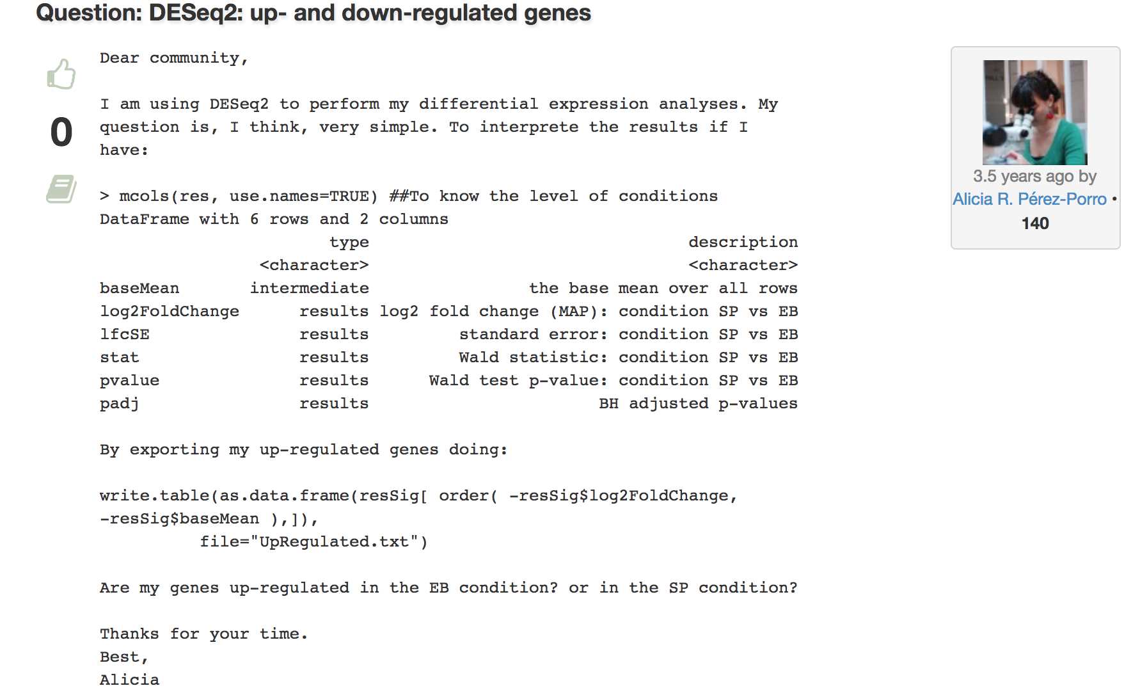
What is where – upregulated vs downregulated
Notes:
https://support.bioconductor.org/p/59790/
Positive log fold change for SP vs EB means up-regulated in SP.
Negative log fold change means down-regulated in SP.
> 3. I don't understand with if I am entering the conditions like
> "condition = factor(c("SP", "SP", "EB", "EB")))" then is
comparing
> EB vs. SP. I would have thought the opposite.
R has the habit of sorting the names of the factor level by alphabet
if
you don't explicitly tell it the order you want. And then, DESeq2
compares by default the alphabetically last versus the first.
If you want something else, just tell it what you want:
res <- results( dds, contrast = list( "condition", "EP", "SP" ) )
to compare SP versus EP.

